Slide 1

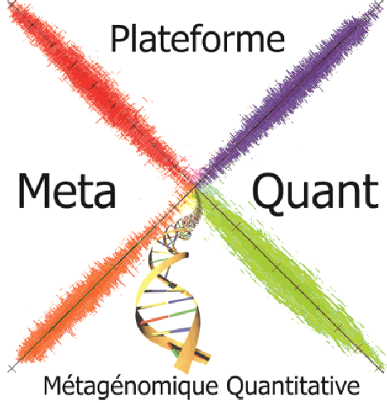

MetaQuant
A new platform dealing with DNA samples to produce metagenomic analysis.
A use case for big data.
Nicolas Pons
INRA
Institut Micalis
Plateforme MetaQuant
Jouy-en-Josas, France
6th International dCache workshop

Slide 2
What is MetaQuant ?
Sequencing and metagenomic analysis platform dedicated to the study of the human microbiota.
Scientific leaders : Sean Kennedy and Dusko Ehrlich
DNA/RNA sequencing : Nathalie Galleron and Benoit Quinquis
(Bio)informatics : Jean-Michel Batto, Nicolas Pons and Pierre Léonard
Statistics and analysis : Emmanuelle Lechatellier and Edi Prifti

Slide 3
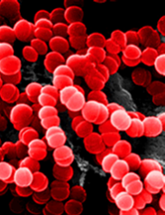
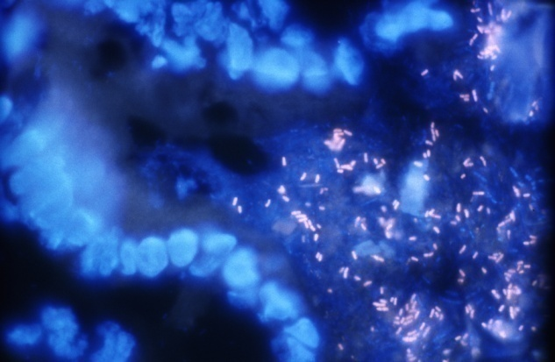
The human intestinal microbiota is a forgotten organ…
100 trillion microorganisms ; 10-fold more cells than the human body; 2 kg of mass!
Interface between food and epithelium
In contact with the 1st pool of immune cells and the 2nd pool of neural cells of the body
…with a major role in health & disease !

Slide 4

Most of microorganisms are unknown and uncultivable…
Hayashi 2002 Tannock 2000 Suau 1999 | 30% 21-37% 21-32%
Use of Metagenomics

Slide 5
What is metagenomics ?
Metagenome
can be defined as the ensemble of genes of the microbes from a given ecological niche.
Metagenomics
allows to characterize composition, properties and dynamics of a microbiome by studying the metagenome.

Slide 6
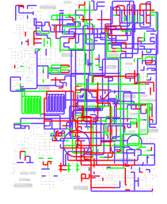


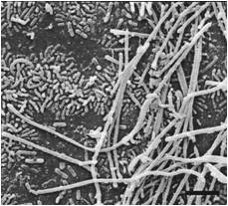
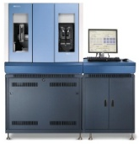

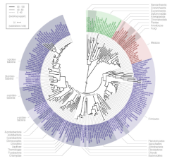

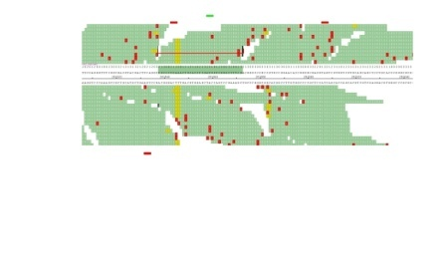
Quantitative metagenomics pipeline
High throughput Sequencing
Reference sequence matching
Gene counting
Biological exploration
Diagnostic
Sample collecting & processing
Mapping the short reads and counting the genes
Metabolism
reconstruction
Stool sample
Gene abundance profiles in different samples
Statistical analysis & diagnostic
Ecosystem
reconstruction
Reference gene catalog
Genetic variability
A powerful microscope!

Slide 7
Our sequencing production
MetaQuant platform (since 2008)
  2 SOLiD 5500xl
  More than 1200 sequenced samples
  40E9 short read sequences
  500E10 bases
  650000 files for 31 TB
Human Genome Project (2001)
  3 years
  16 sequencing centers
  22E9 bases

Slide 8
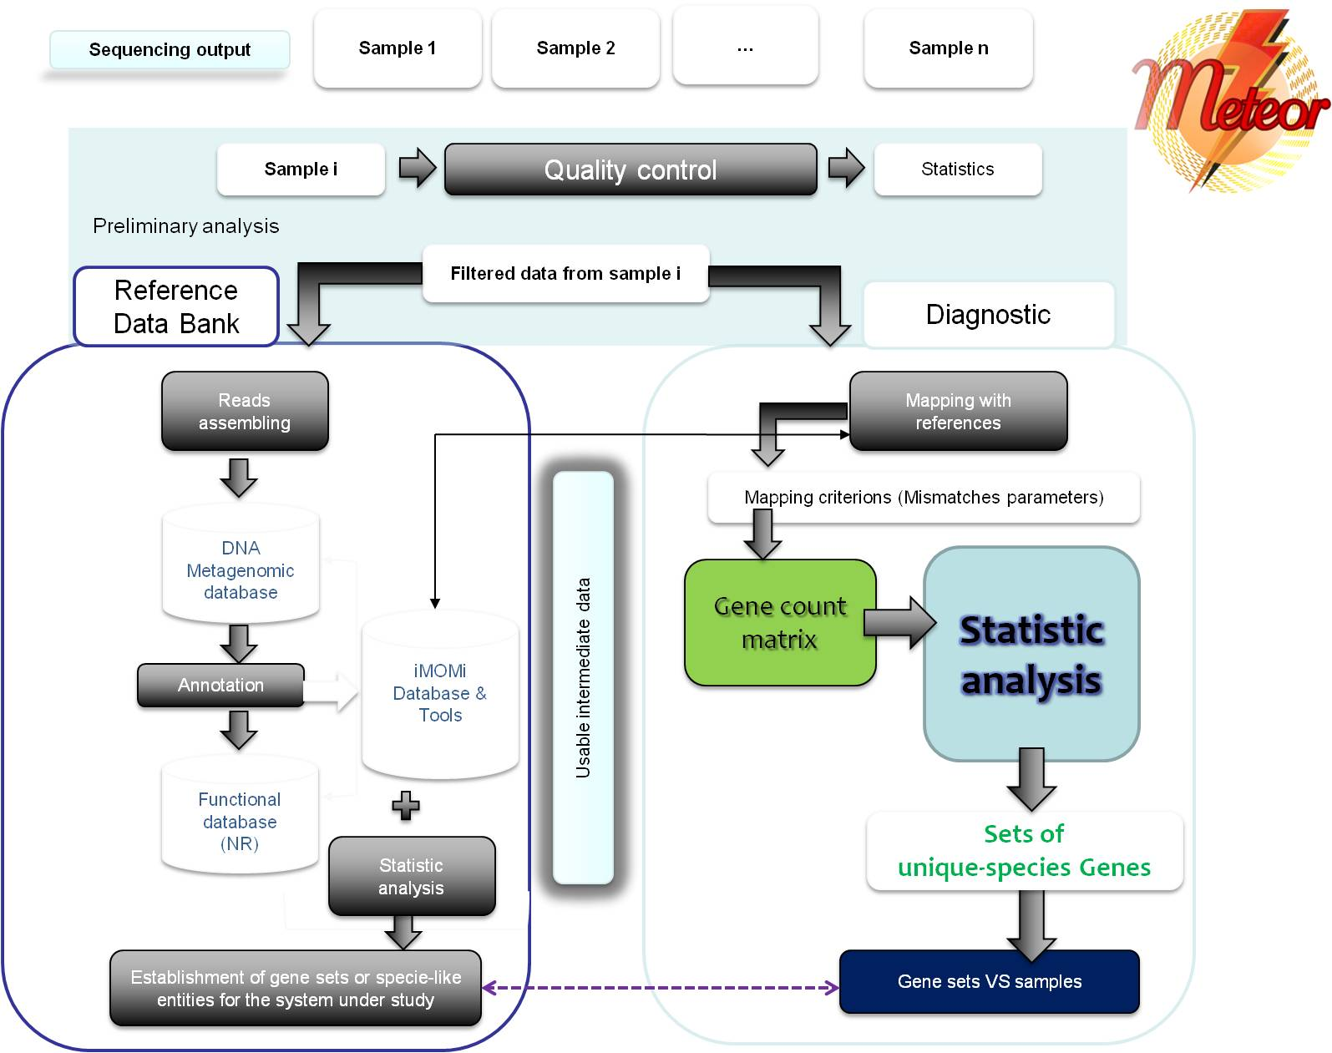
Our analysis pipeline : Meteor
250GB
24 files
Primary data evolution
Per week
1TB
~20000 files

Slide 9
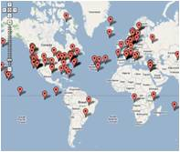
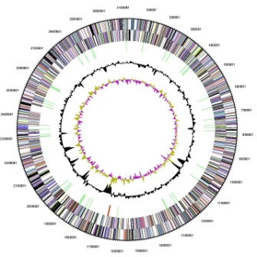
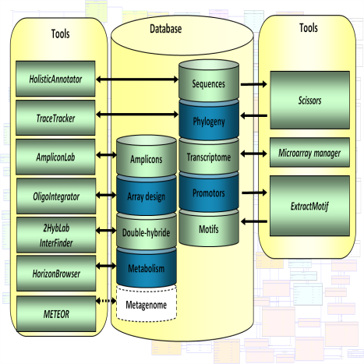
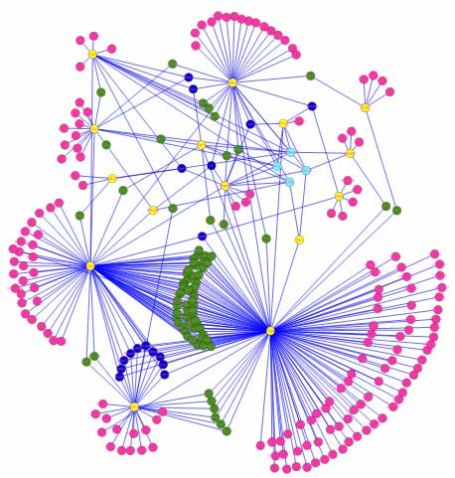
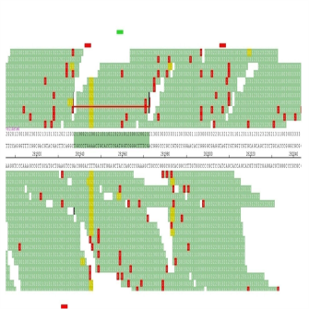

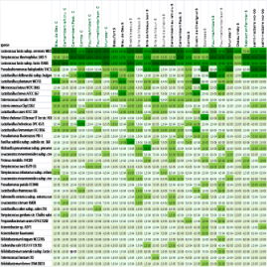
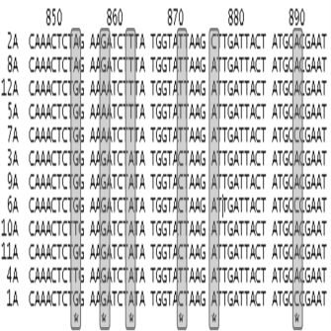

Our data managment system : iMOMi
Samples
Metadata
Reference
iMOMi
Clusters
Mapping
SQL system
PostgreSQL
AdvantageDB
ZFS
NFS and Samba export
Gene Profiles
SNPs
NoSQL system
APP : IDDN.FR.001.080038.000.R.P.2007.000.31235
http://locus.jouy.inra.fr/imomi
(Pons ,et al., 2008)

Slide 10
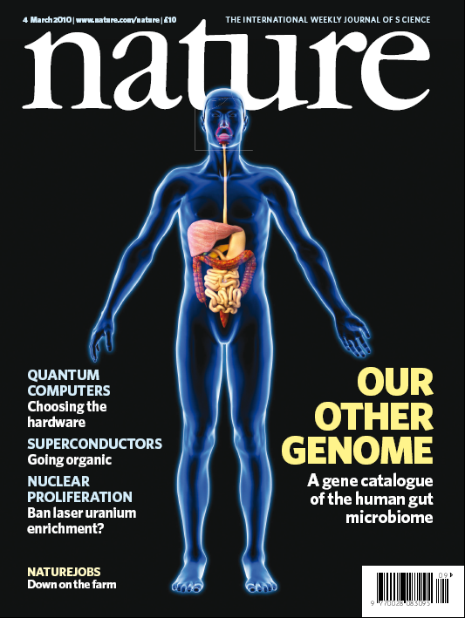

Our other genome the human intestinal metagenome
March 2010
3.3 million microbial gene catalog
150-fold human genome

Slide 11
Enterotypes of the human gut microbiome
Danes
n=85; Illumina
Europeans, Americans, Asians. n=33; Sanger
US
n=154; 454
Enterotypes can be likened to blood groups but the reasons for their existence remains to be elucidated
Nature, 2011

Slide 12
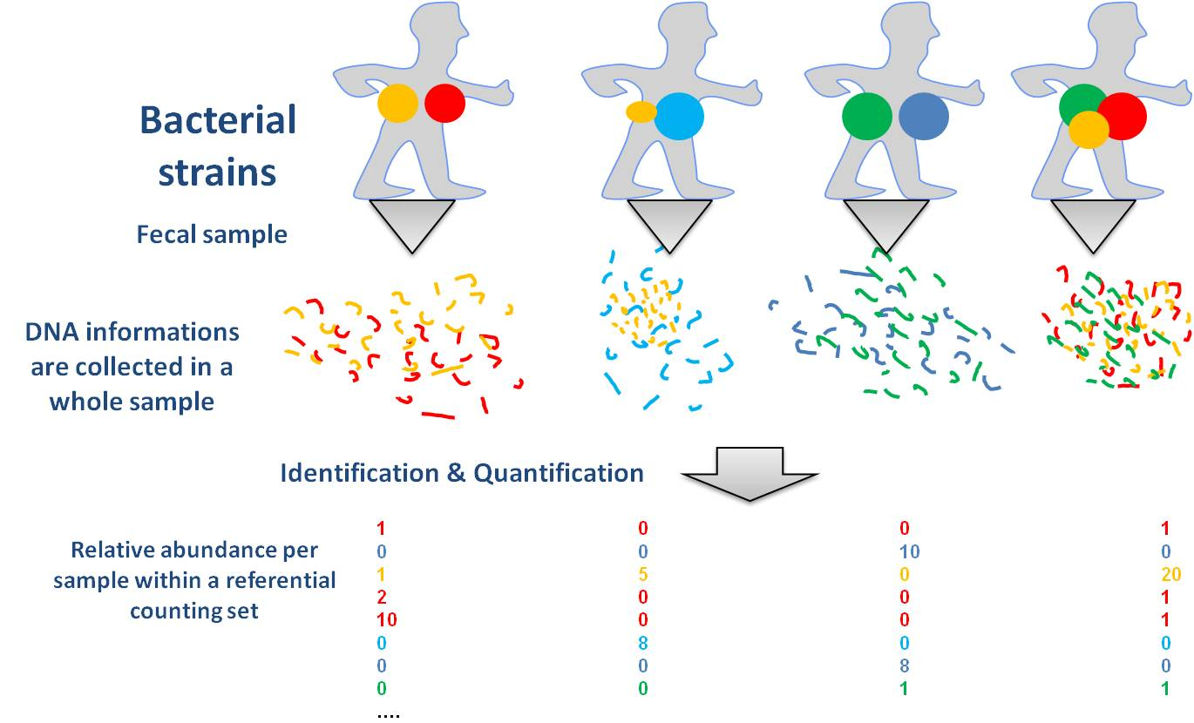

~800 metagenomic species discovered with massive GPU computation
Hierarchical descendant graph & DAPC clustering
  By computation of spearman correlation
  3.3E6 x 800 → 5E12 correlations to calculate
  With one CPU : more than a year to do it…
MetaProf
  CUDA programming
  2H with 40 GPU (Titane/CCRT deployment)
(Almeida et al., 2012 in preparation)

Slide 13
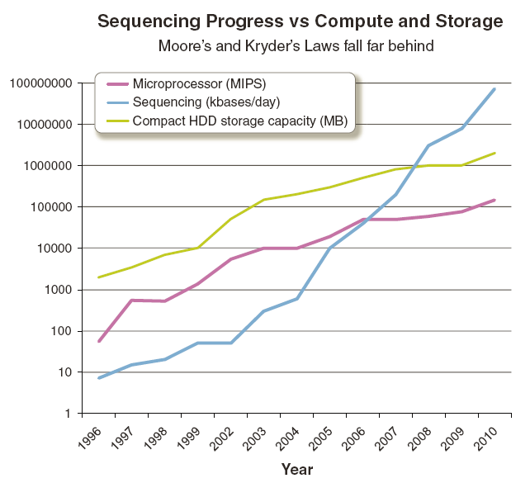
MetaQuant works well, but…

Slide 14
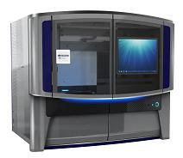
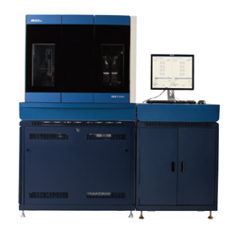
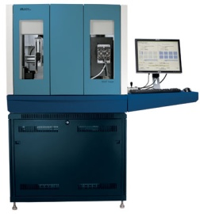
MetaQuant…
2009
3TB
2011
17TB
April 2012
31TB
650000 files
10E13 tuples

Slide 15

… to MetaGenoPolis
Pre-industrial demonstrator launched at INRA in 2012
On the way of the Petabyte !!!
dCache could be the solution

