Slide 2
Content
WLCG federated storage
The catalogue synchronization solution
Redirection using http federation
Redirection on error

Slide 3
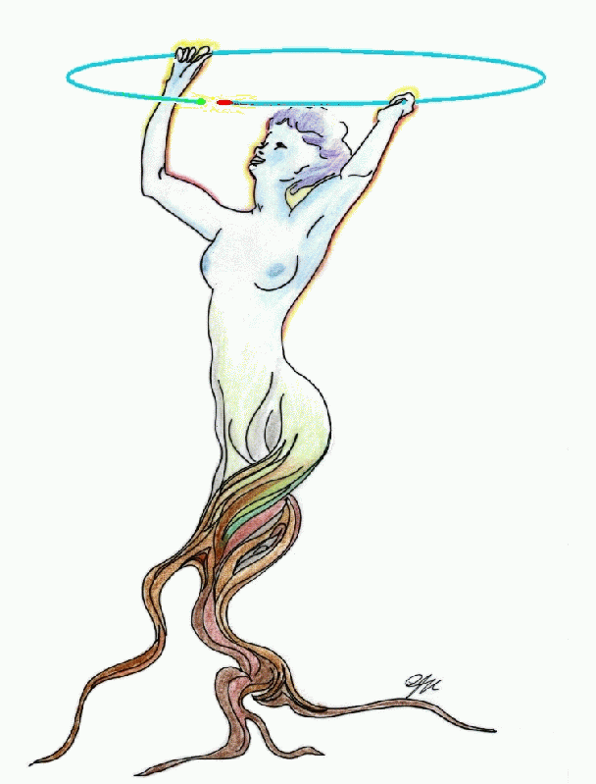
How is WLCG federating storage
Storage
Elements
store
SE
Client
LFC
Catalogues
register
ROOT
NON-ATOMIC
Problem:
Often results in dangling references
(and “dark” data)

Slide 4
Suggested solution: CAT-SYNC
SE Sends to the appropriate topics (e.g. “Changes”)
Stolen from
Fabrizio
Subscribes to the relevant topics (e.g. “Lost”)
Central
Catalogue
Other
catalogue/SE
e.g. ATLAS
SE sends to the appropriate topics (e.g. “Lost”)
Broker(s)
SE or exp. catalogue subscribes to the relevant topics (e.g. “Changes”)
EMI INFSO-RI-261611
SE1
SE2
SEn
Propagates “Lost File” events to catalogues

Slide 5
Good for now
Is a sufficient solution for now
But there might be better ones

Slide 6

Our Goal
  Provide transparent access to data through catalogues, using standard protocols : http(s), WebDAV
  Redirection from catalogues to the final data source doesn’t require intermediate steps by the user but is part of the protocol.
LFC
storage element
Web
DAV
storage element
storage element
ROOT

Slide 7
How does it work
FILE FOUND
FILE NOT FOUND
‘dir’ request
Or GET LFN
LFC
File list or
SURL
LFC
Redirect SURL
User Clicks
NEW
Request SURL
get request
Quick Hack
SE-1
Mapping Service
redirect
Return TURL
SE
Instead of
File Not Found
Redirect
GET TURL
Head Node
get request
Redirect
SE-2
GET TURL
Data Pool
DATA
DATA

Slide 8
NEW: Redirection on error
Global Catalogue
Provides clients with encoded alternatives.
Storage Elements interpret the provided alternatives.
And create a redirection

Slide 9
Redirection on error
Transparent for the client
Provides feedback to redirectors
Utilizes HTTP standards only

Slide 10
Redirection on error
https://<se-replica-1>/sfn/replica/1?
rid=1&
r1=3,https://<se-replica-3>/sfn/replica/3&
r2=5,https://<se-replica-5>/sfn/replica/5&
r3=-1,https://<catalog>/lfn/of/file

Slide 11
Redirection on error
https://<se-replica-3>/sfn/replica/3?
rid=3&
notfound=1&
r1=5,https://<se-replica-5>/sfn/replica/5&
r2=-1,https://<catalog>/lfn/of/file

Slide 12
Redirection on error
https://<se-replica-5>/sfn/replica/5?
rid=5&
forbidden=3&
notfound=1&
r1=-1,https://<catalog>/lfn/of/file

Slide 13
Redirection on error
https://<catalog>/lfn/of/file?
forbidden=3&
notfound=1,5

Slide 14
Next Step
Best
Match
Engine
GET LFN
Candidate
Collection
Engine
Portal
LFC
Redirect SURL
Query SE’s for file
e.g. http GET (header)
Request SURL
Quick Hack
Mapping service
Return TURL
SE
Redirect
SE
SE
GET TURL
Head Node
Redirect
GET TURL
Data Pool
DATA

Slide 15

DEMO @ Hepix (Thursday)
GEO
IP
Best
Match
Engine
Candidate
Collection
Engine
Portal
DPM@Taipei
dCache@DESY
Telecom cloud @Germany

Slide 16
Thanks

